Slide 1

Decision Making Fundamentals
There is a Clever Description of this Somewhere in My Brain

Slide 2




Kenneth Craik’s Model
An intelligent automaton…
Uses a small-scale model of world
Can perform actions
Knows effects of actions
Uses inference to make decisions
Notes:
(1:00 before activity)
(1:30 for activity) (3:30 for last part)
Total: 10:30

Slide 3

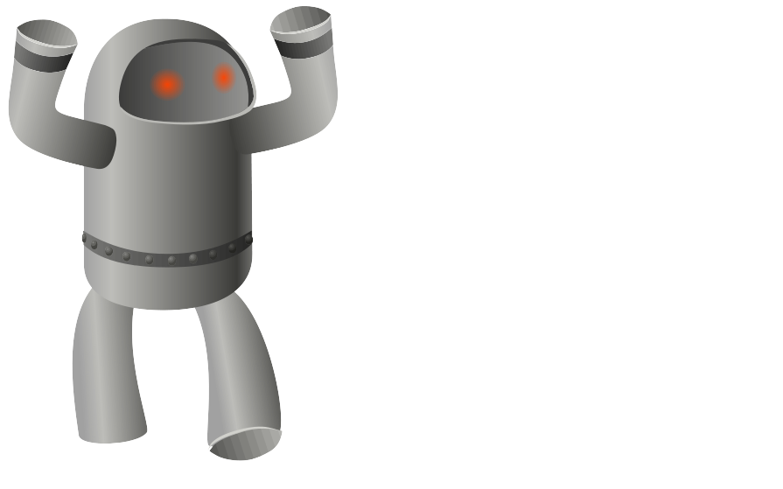
General Agent Architecture
The architecture of an agent will dictate how information comes in and is used.
WORLD
Percepts
AGENT
Event Handler
Knowledge
Behavior
Actions
Notes:
(1:00)

Slide 4
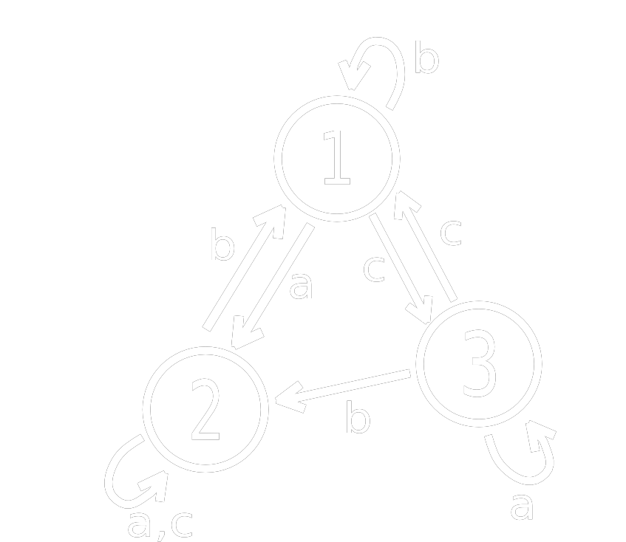
Finite State Machines
Finite State Machines
Memory is only the current state
State transitions defined by mapping
Inputs consumed in receipt order
Changes triggered by input
a
b
b
c
b
Notes:
(2:20)

Slide 5
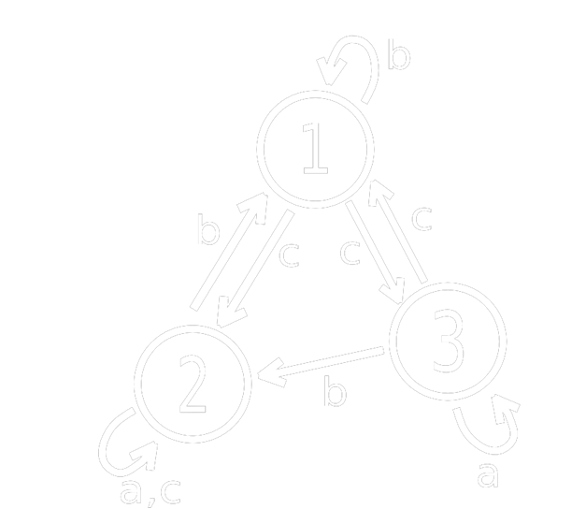
Determinism vs. Non-Determinism
Deterministic FSMs:
Are completely predictable
Have exactly one action for each input
Non-deterministic FSMs:
Are unpredictable*
Can have any number actions for an input

Slide 6
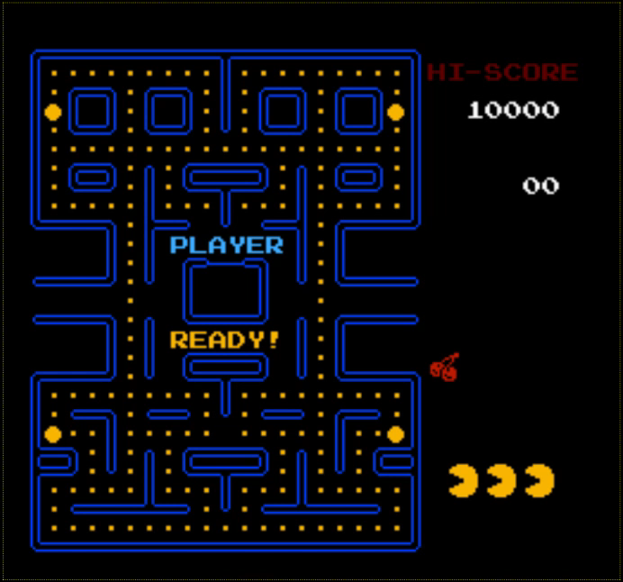
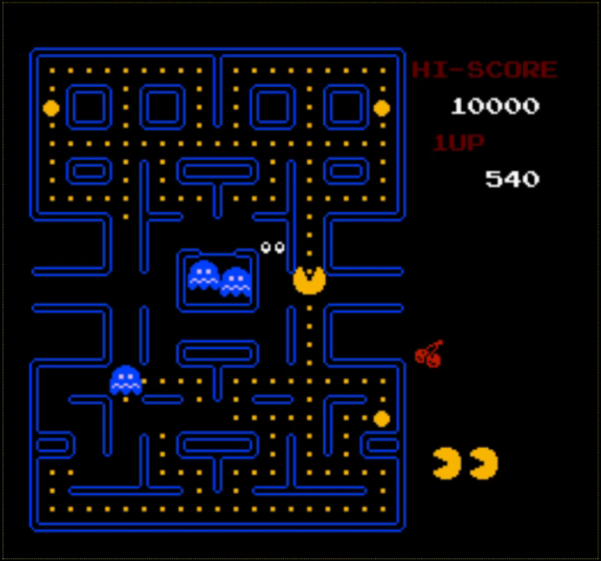
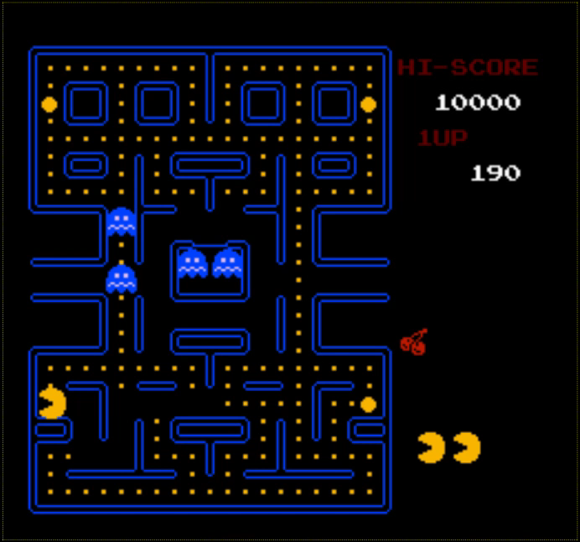
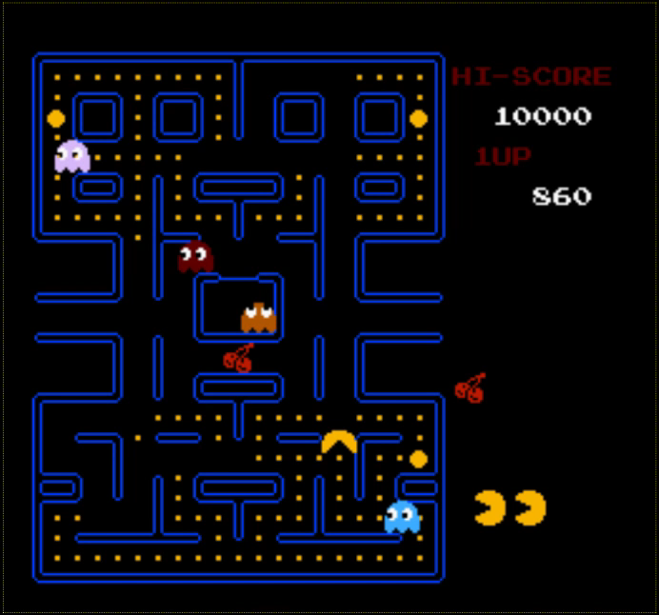
FSMs in Games
Structure
Every frame, current state runs code
In its first update, a state should initialize
In its last update, a state should have exit code
Transitions
Transitions are be stored in a transition table
Machines use engine events as input
Scatter
C_TIMER
PILL
C_TIMER
EATEN
Chase
P_TIMER
PILL
Flee
PILL
Notes:
(3:10)
Total: 20:00

Slide 7

Example FSM Architecture
class StateMachine
{
list<State*> states;
State *current, *start;
int transition[#s][#i];
queue<Event*> events;
void Init();
void Update();
void Shutdown();
void EnqueueEvent(Event*);
void Transition();
}
class State
{
void enter();
void update();
void exit();
}

Slide 8
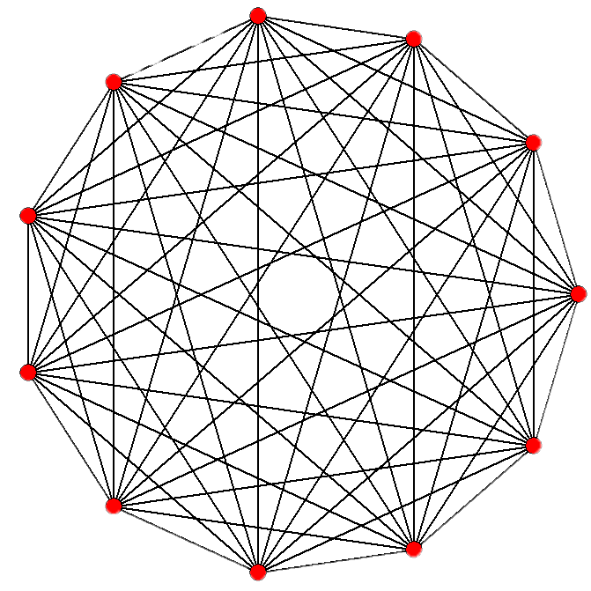
FSM Problems
Finite State Machines are easy to code and have been very successful in games, but have some problems:
Not easily scalable
No memory of past events
Purely reactive – no plans/goals
Can be too predictable
Scaling can be handled to some degree with Hierarchical FSMs (HFSMs), and predictability can be addressed with probabilities – but there is a cost!
Notes:
(1:50)

Slide 9

Decision Trees
Decision trees help agents make decisions (behavior) by branching based on aspects of the world (knowledge).
Decision Trees…
Ask some question about world / agent
Branch according to possible answers
Terminate in decisions (leaf nodes)
Decision trees can use machine learning (ID3)
Decision tree models are simple but have limited flexibility.
Zombie?
Yes
No
Hungry?
Yes
No
Hide
Eat Brains
Moan
Notes:
(1:10)
Total: 23:00

Slide 10

Behavior Trees
To model more complex agent behaviors, we can use Behavior Trees.
Primitives
Conditions
Actions
Decorators
Loop
Invert
Composites
Sequences
Selectors
Parallels
After a behavior runs, it returns a status:
Success (completed)
Failure (did not complete)
Running (suspended to return later)

Slide 11
Fin

